Slide 1


Virtual Networks

Slide 2



Configure Virtual Networks

Slide 3

Plan Virtual Networks
Virtual Network
Subnet
On-premises
NIC
NIC
Virtual Network(s)
Virtual Machines
Logical representation of your own network
Create a dedicated private cloud-only virtual network
Securely extend
your datacenter with virtual networks
Enable hybrid
cloud scenarios

Slide 4
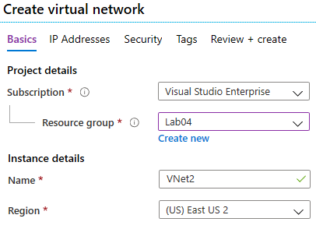
Create Virtual Networks
Create new virtual networks
at any time
Add virtual networks when you create a virtual machine
Define the address space, and at least one subnet
Check for overlapping address spaces
Notes:
QuickStart: Create a virtual network using the Azure portal - https://docs.microsoft.com/azure/virtual-network/quick-create-portal
✔️ Always plan to use an address space that is not already in use in your organization, either on-premises or in other VNets. Even if you plan for a VNet to be cloud-only, you may want to make a VPN connection to it later. If there is any overlap in address spaces at that point, you will have to reconfigure or recreate the VNet. The next lesson will focus on IP addressing.

Slide 5
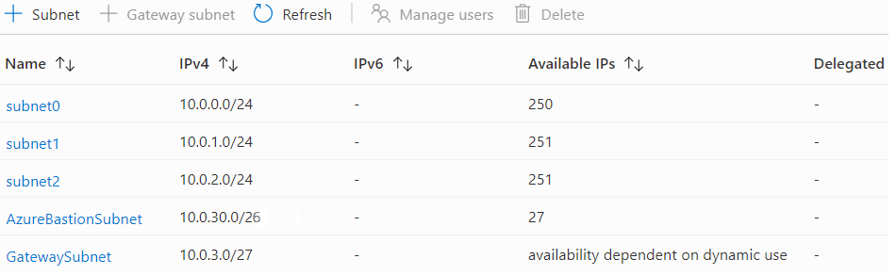
Create Subnets
A virtual network can be segmented into one or more subnets
Subnets provide logical divisions within your network
Subnets can help improve security, increase performance, and make it easier to manage the network
Each subnet must have a unique address range – cannot overlap with other subnets in the vnet in the subscription
Notes:
✔️ Azure reserves 5 IP addresses within each subnet.
x.x.x.0: Network address
x.x.x.1: Reserved by Azure for the default gateway
x.x.x.2, x.x.x.3: Reserved by Azure to map the Azure DNS IPs to the VNet space
x.x.x.255: Network broadcast address

Slide 6
Plan IP Addressing
Azure
Resource
Internet, public-facing services
VNets, on-premises networks, VPN gateways, ExpressRoute
Private IP address
Public IP address
Private IP addresses - used within an
Azure virtual network (VNet), and your
on-premises network, when you use a VPN gateway or ExpressRoute circuit to extend your network to Azure
Public IP addresses - used for communication with the Internet, including Azure public-facing services
Notes:
Design an IP addressing schema for your Azure deployment – https://docs.microsoft.com/learn/modules/design-ip-addressing-for-azure
✔️ As a best practice you may decide to separate dynamically and statically assigned IP resources into different subnets. And, IP Addresses are never managed from within a virtual machine.

Slide 7
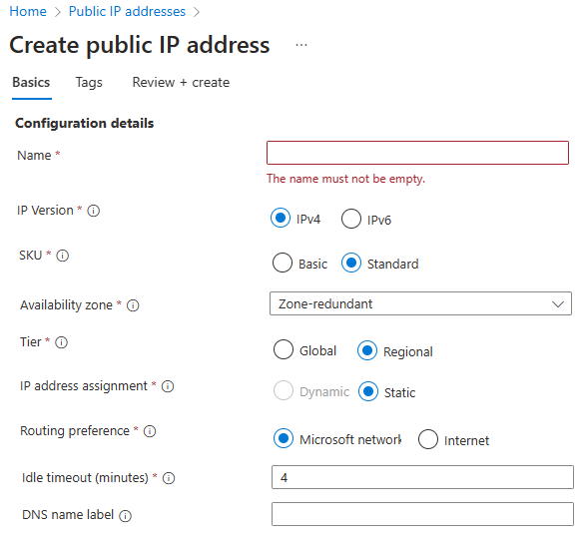
Create Public IP Addresses
Available in IPv4 or IPv6 or both
Basic vs Standard SKU
Dynamic vs Static
Microsoft vs. internet routing
Notes:
Create, change, or delete IP addresses - https://docs.microsoft.com/azure/virtual-network/virtual-network-public-ip-address

Slide 8
Associate Public IP Addresses
Public IP addresses | IP address association | Dynamic | Static
Virtual Machine | NIC | Yes | Yes
Load Balancer | Front-end configuration | Yes | Yes
VPN Gateway | Gateway IP configuration | Yes | Yes*
Application Gateway | Front-end configuration | Yes | Yes*
A public IP address resource can be associated with virtual machine network interfaces, internet-facing load balancers, VPN gateways, and application gateways
*Static IP addresses only available on certain SKUs.
Notes:
Public IP addresses - https://docs.microsoft.com/azure/virtual-network/public-ip-addresses

Slide 9
Allocate or Assign Private IP Addresses
Private IP Addresses | IP address association | Dynamic | Static
Virtual Machine | NIC | Yes | Yes
Internal Load Balancer | Front-end configuration | Yes | Yes
Application Gateway | Front-end configuration | Yes | Yes
Dynamic (default). Azure assigns the next available unassigned or unreserved IP address in the subnet’s address range
Static. You select and assign any unassigned or unreserved IP address in the subnet's address range
Notes:
Private IP addresses - https://docs.microsoft.com/azure/virtual-network/private-ip-addresses

Slide 10
Demonstration – Virtual Networks
Create a virtual network in the Azure portal
Configure subnets
Create a public IP address

Slide 11
Configure Network Security Groups (NSGs)

Slide 12
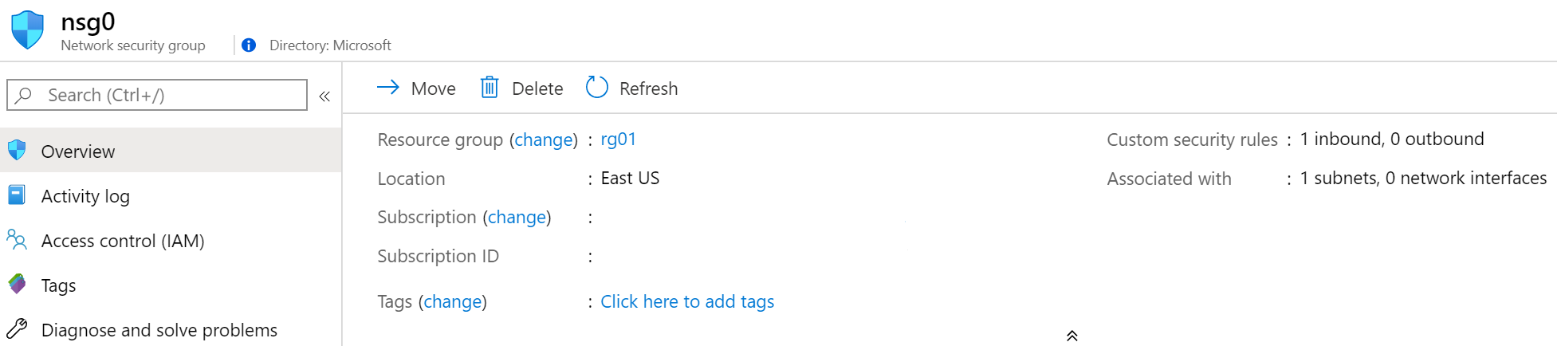
Implement Network Security Groups
Limits network traffic
to resources in a
virtual network
Lists the security rules that allow or deny inbound or outbound network traffic
Associated
to a subnet or a
network interface
Can be associated multiple times
Notes:
Network Security Groups - https://docs.microsoft.com/azure/virtual-network/security-overview#network-security-groups
✔️ To simplify management of security rules, it's recommended that you associate a network security group to individual subnets, rather than individual network interfaces within the subnet.

Slide 13
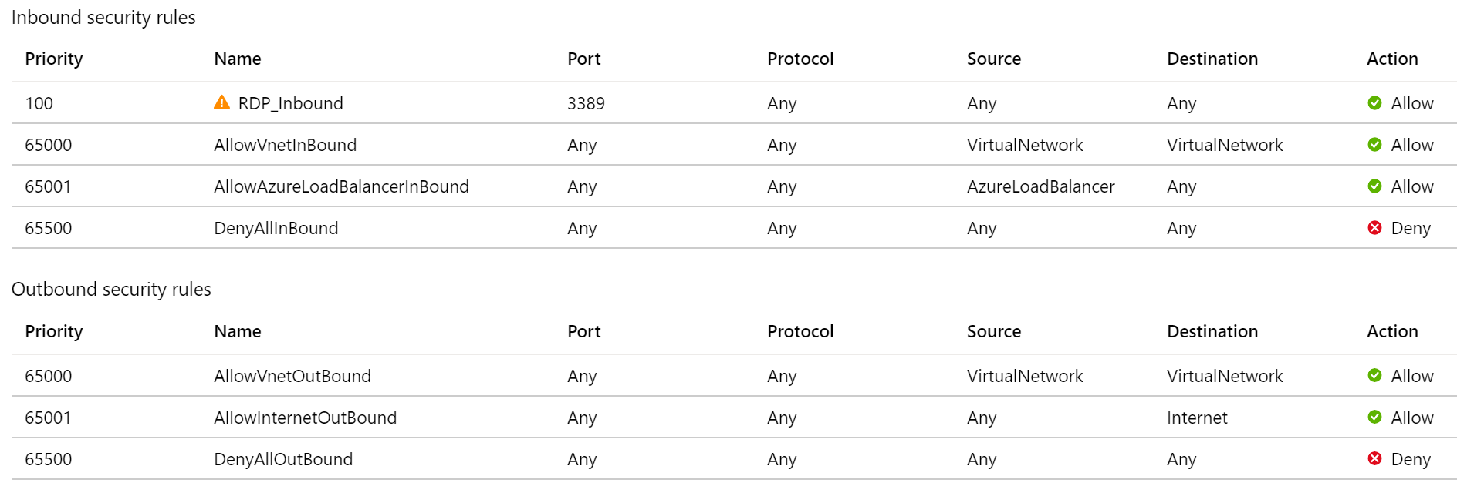
Determine NSG Rules
Security rules in NSGs enable you
to filter network traffic that can flow
in and out of virtual network subnets and network interfaces
There are default security rules.
You cannot delete the default rules,
but you can add other rules with
a higher priority
Notes:
Create, change, or delete a network security group -https://docs.microsoft.com/azure/virtual-network/manage-network-security-group

Slide 14
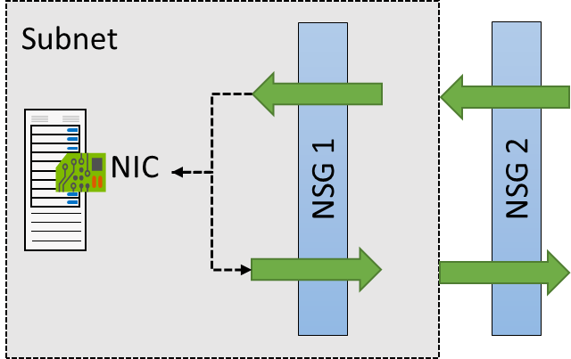
Determine NSG Effective Rules
NSGs are evaluated independently for the
subnet and NIC
An “allow” rule must exist
at both levels for traffic to
be admitted
Use the Effective Rules link if you are not sure which security rules are being applied

Slide 15
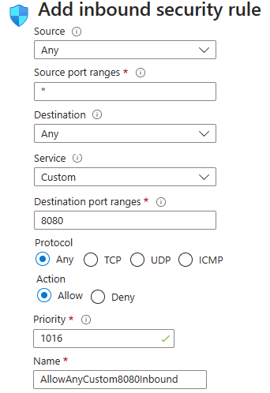
Create NSG rules
Source (Any, IP addresses, My IP address, service tags, and application security group)
Destination (Any, IP addresses, service tag, and application security group)
Service (HTTPS, SSH, RDP, DNS, POP3, custom, …)
Priority – The lower the number, the higher
the priority
Notes:
Tutorial: Filter network traffic with a network security group using the Azure portal - https://docs.microsoft.com/azure/virtual-network/tutorial-filter-network-traffic
Secure and isolate access to Azure resources by using network security groups and service endpoints - https://docs.microsoft.com/learn/modules/secure-and-isolate-with-nsg-and-service-endpoints/

Slide 16





Implement Application Security Groups
Extends your application's structure
ASGs logically group virtual machines – web servers, application servers
WebServers
AppLServers
Define rules to control the traffic flow
Wrap the ASG with an NSG for added security
Source | Destination | Port
Internet | WebServers | 80, 443
WebServers | SQLServers | 1433
Notes:
There is no associated student material.
Application Security Groups - https://docs.microsoft.com/azure/virtual-network/application-security-groups

Slide 17
Demonstration – Network Security Groups
Create a network security group
Explore inbound and outbound rules

Slide 18
Host your Domain on Azure DNS

Slide 19
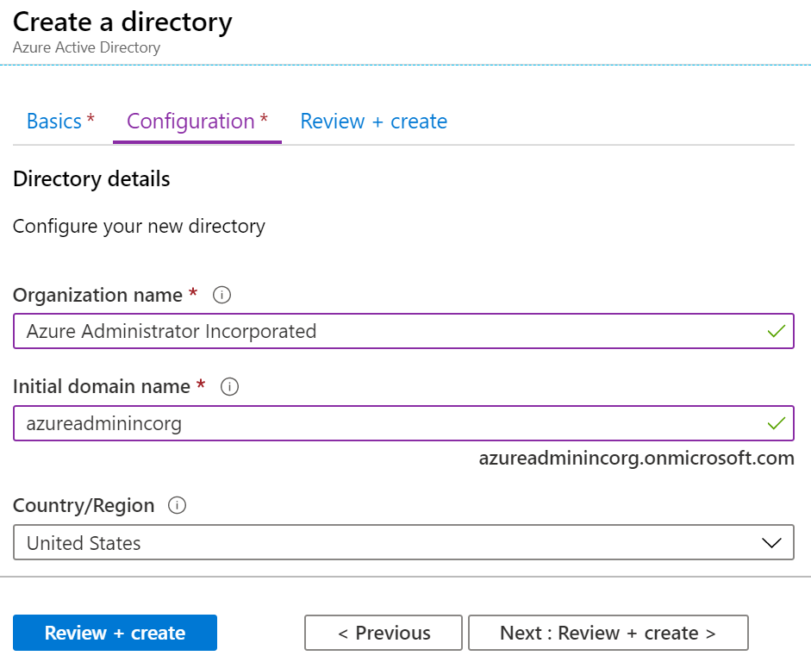
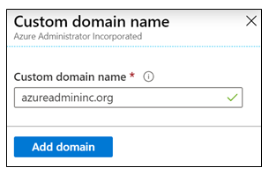
What is Azure DNS?
When you create a new tenant, a new default domain is created
The domain has initial domain name in the form domainname.onmicrosoft.com
You can add a custom domain name
After the custom name is added it must be verified – this demonstrates ownership of the domain

Slide 20
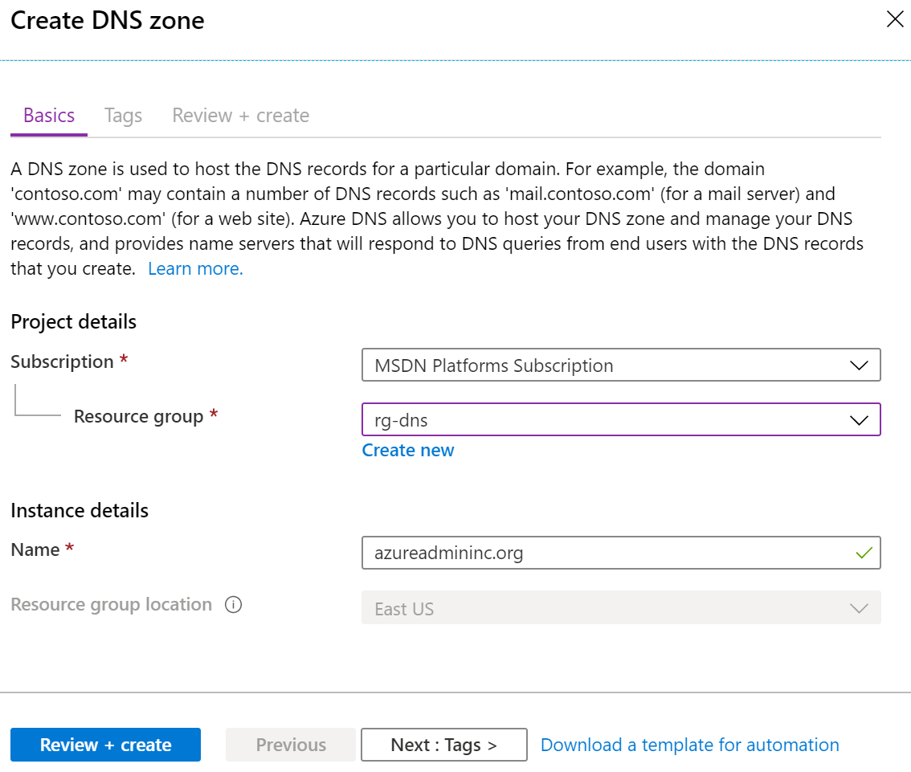
Configure Azure DNS to host your domain
A DNS zone hosts the DNS records for a domain
Where multiple zones share the same name,
each instance is assigned different name server addresses
Root/Parent domain is registered at the registrar and pointed to Azure NS
Notes:
DNS Zones - https://docs.microsoft.com/azure/dns/dns-zones-records#dns-zones
✔️ You do not have to own a domain name to create a DNS zone with that domain name in Azure DNS. However, you do need to own the domain to configure the domain.

Slide 21
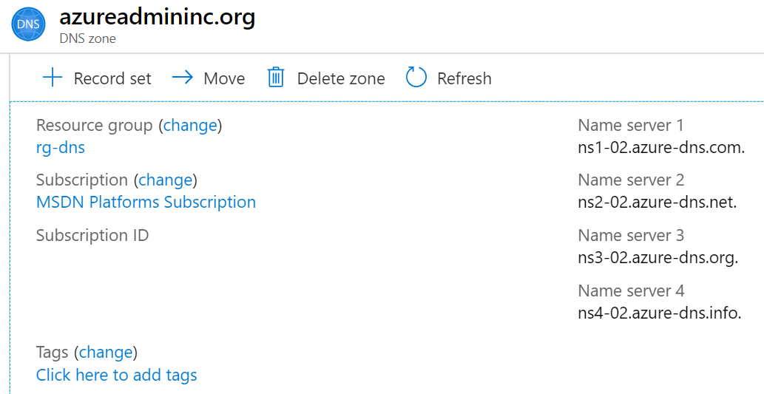
Verify delegation of domain name services
When delegating a domain to Azure DNS, you must use all four name server names provided by Azure DNS
Once the DNS zone is created, update the parent registrar
For child zones, register the NS records in the parent domain

Slide 22
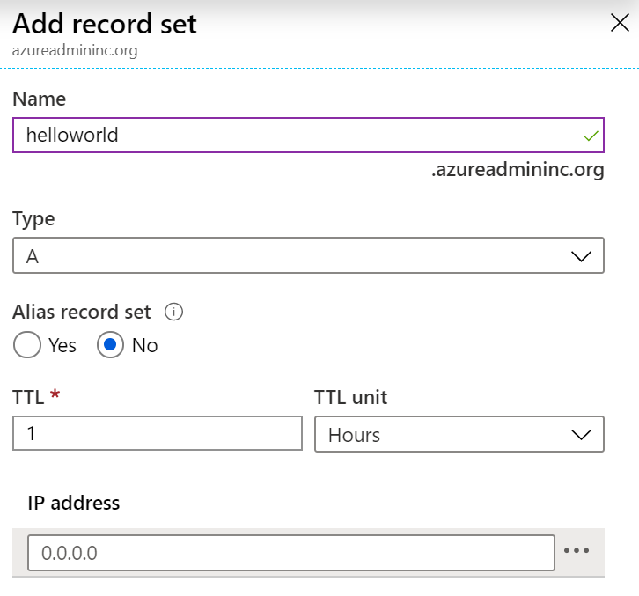
Dynamically resolve resource name by using alias record
A record set is a collection of records in a zone
that have the same name and are the same type
You can add up to 20 records to any record set
A record set cannot contain two identical records
Changing the drop-down Type, changes the information required

Slide 23
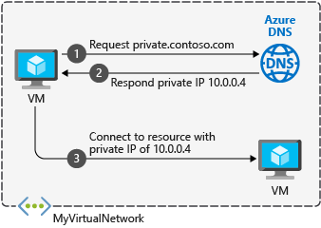
Configure a private DNS zone
Use your own custom domain names
Provides name resolution for VMs within a VNet and between VNets
db.contoso.lab
Automatic hostname record management
Removes the need for custom DNS solutions
Use all common DNS records types
Available in all Azure regions
Notes:
QuickStart: Create an Azure private DNS zone using the Azure portal - https://docs.microsoft.com/azure/dns/private-dns-getstarted-portal

Slide 24
Demonstration - DNS
Create a DNS zone
Add a DNS record set
View the name servers

Slide 25
Lab – Implement Virtual Networks

Slide 26
Lab 04 – Implement Virtual Networking
Job Skills
This lab is the first of three labs that focus on virtual networking.
In this lab, you learn the basics of virtual networking and subnetting.
You learn how to protect your network with Network Security Groups and Application Security Groups.
You learn how to configure Azure DNS.
Task 1: Create a virtual network with subnets using the portal.
Task 2: Create a virtual network and subnets using a template.
Task 3: Create and configure communication between an Application Security Group and a Network Security Group.
Task 4: Configure public and private Azure DNS zones.
Notes:
This is the first of three networking labs. In this lab you are covering basic network infrastructure.
Lab 04 - https://microsoftlearning.github.io/AZ-104-MicrosoftAzureAdministrator/Instructions/Labs/LAB_04-Implement_Virtual_Networking.html

Slide 27



Lab 04 – Architecture diagram
az104-rg4
Task 1
Task 2
CoreServicesVnet
(10.20.0.0/16)
Task 3
ManufacturingVnet
(10.30.0.0/16)
SharedServicesSubnet
(10.20.10.0/24)
SensorSubnet1
(10.30.20.0/24)
DatabaseSubnet
(10.20.20.0/24)
SensorSubnet2
(10.30.21.0/24)
contoso.com
Task 4
private.contoso.com

Slide 28




Lab 04 – Architecture diagram (interactive lab simulation)
Task 1, Task 2
az104-04-rg1
az104-04-vnet1 10.40.0.0/20
Subnet0 10.40.0.0/24
Subnet1 10.40.1.0/24
Task 5
Private DNS zone
az104-04-vm0
az104-04-vm1
contoso.org
az104-04-nic0
10.40.0.4
az104-04-nic1
10.40.1.4
Task 3
Task 6
az104-04-pip0
az104-04-pip1
DNS zone
Task 4
az104-04-nsg01
Notes:
This is the architecture diagram for the interactive simulation (previous lab), if you want to review that.

Slide 29
Thank You!

